Slide 1
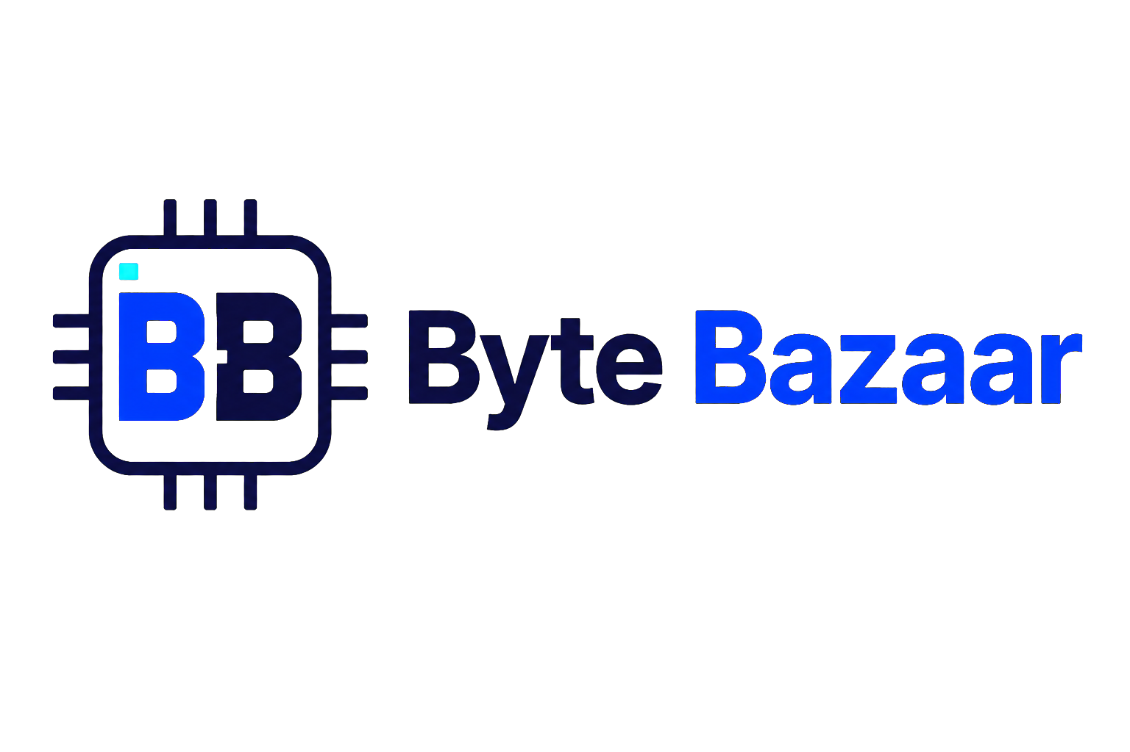
Byte Bazaar Project
Presentation
From Economic Analysis to Functional and Technical Specifications
Ryan Coon
SWE-540
Professor Ali Wahid
August 5, 2026
Notes:
Welcome to my presentation on the Byte Bazaar project. Over the next 15 minutes, I will provide a detailed overview of the project, starting from the economic analysis and team leadership aspects, moving through the design of functional and technical specifications, and concluding with how we apply the Software Development Life Cycle to ensure a successful software development process. This presentation aims to give a holistic view of how Byte Bazaar is planned, developed, and managed.

Slide 2
What is Byte Bazaar?
A computing-based e-commerce system built around four priorities.
01
02
03
04
Online buying & selling
Usability
Security
Scalability
Purpose
Meet customer and business needs efficiently through a reliable online marketplace.
02
Notes:
Byte Bazaar is envisioned as a comprehensive e-commerce platform that enables users to browse, select, and purchase products online with ease. The system is designed with a strong focus on usability to ensure a smooth user experience, security to protect sensitive data and transactions, and scalability to support growth in users and product listings. It serves both end customers and administrators who manage product inventories and orders.

Slide 3
Project Goals and Business Needs
Improve customer shopping experience
Create a scalable system for future growth
Provide secure transactions
Ensure reliable performance under realistic constraints
Support efficient product and order management
03
Notes:
The primary goals of Byte Bazaar are to improve the online shopping experience, ensure secure transactions, and provide the business with effective tools for managing products and orders. The system must also be scalable so it can grow as demand increases. In addition, the development process must address realistic constraints such as budget, timeline, technical resources, and operational needs.

Slide 4
Economic Analysis of Byte Bazaar
INVESTMENT
EXPECTED VALUE
Development labor
Improved sales opportunities
Software & hardware
Reduced manual processes
Infrastructure, hosting & maintenance
Long-term return on investment
Economic question: Do the expected business benefits justify total development and operating costs?
04
Notes:
The economic analysis phase involved a thorough assessment of all costs associated with the project, including software development labor, hardware and infrastructure expenses, and ongoing maintenance. We also projected the benefits, such as increased revenue from online sales, improved operational efficiency by automating manual processes, and enhanced customer retention through better service. By comparing these costs and benefits, we established a positive return on investment, justifying the project’s continuation. Additionally, we evaluated risks such as market competition and technology changes to ensure informed decision-making.

Slide 5
Team Leadership and Collaboration
01
02
03
04
05
Communicate clearly
Define ownership
Collaborate & give feedback
Manage tasks & deadlines
Track milestones
Strong leadership keeps planning, analysis, design, and implementation aligned to the same project goals.
05
Notes:
Effective team leadership is critical to project success. For Byte Bazaar, roles were clearly defined to ensure accountability: developers focused on coding, testers on quality assurance, project managers on coordination, and business analysts on requirements gathering. Communication protocols such as daily stand-ups and weekly progress reports kept everyone aligned. Encouraging collaboration helped the team quickly resolve challenges. Setting realistic deadlines and tracking milestones ensured steady progress and timely delivery.

Slide 6
Planning Phase in the SDLC
01
02
03
04
05
Define scope
Identify stakeholders & requirements
Evaluate feasibility
Create schedule & milestones
Assess risks & resources
Foundation first
Early planning makes cost, capability, schedule, and risk visible before development accelerates.
06
Notes:
During planning, we clearly defined the scope of Byte Bazaar to avoid scope creep and set achievable objectives. Feasibility studies assessed whether the project was technically possible, operationally viable, and economically justified. Risks such as technology limitations and market shifts were identified early, with mitigation plans developed. A detailed schedule outlined key milestones, and resources were allocated to ensure the project stayed on track.

Slide 7
Planning and Control in the SDLC
Monitor project progress
Ensure quality and accountability
Manage scope, cost, and schedule
Keep deliverables aligned with goals
Address risks and changes
07
Notes:
The Software Development Life Cycle, or SDLC, provides a structured approach to software development, consisting of six key phases. Planning defines the project scope and resources; analysis gathers detailed requirements; design creates system blueprints; implementation involves coding; testing verifies functionality; and maintenance supports ongoing improvements. Byte Bazaar uses an iterative approach, allowing flexibility to adapt to changes while emphasizing planning and control to manage risks effectively.

Slide 8
WHAT THE SYSTEM SHOULD DO
Functional Specifications
User registration and login
Order tracking and account management
Product search and browsing
Admin product and inventory management
Shopping cart and checkout
Functional requirements translate customer and business needs into observable system behaviors.
08
Notes:
Functional specifications describe what Byte Bazaar must do from the user’s perspective. Key features include user registration and secure login, product search and browsing, shopping cart management, checkout with payment processing, and order tracking. For administrators, features include managing product listings, controlling inventory, and processing orders. Workflow diagrams help visualize user interactions, and acceptance criteria define how each function will be validated.

Slide 9
HOW THE SYSTEM WILL BE BUILT
Technical Specifications
System architecture and database design
Performance and scalability requirements
APIs and backend integration
Hosting and deployment considerations
Security controls and authentication
Technical specifications give developers the blueprint for a reliable, scalable, and secure implementation.
09
Notes:
Technical specifications detail how Byte Bazaar will be built. The system uses a client-server architecture with a web-based frontend accessible via browsers. The backend employs a relational database to store product, user, and order data. APIs integrate payment gateways and other third-party services. Security is paramount, with SSL encryption protecting data in transit, multi-factor authentication securing accounts, and data protection policies in place. Performance considerations include load balancing and caching to ensure the system scales efficiently under high traffic.

Slide 10
System Analysis
01
02
03
04
05
Business needs
Inputs, outputs & workflows
User interactions
Constraints & risks
Requirements vs. objectives
Analysis asks whether the proposed system solves the right problem before design commits to a solution.
10
Notes:
System analysis involved gathering detailed requirements from business stakeholders and users. We identified all inputs, such as user data and product information, and outputs like order confirmations and sales reports. Mapping workflows and data flows helped clarify system operations. Constraints such as budget limits, project timeline, and technology choices were considered. Risks including potential security threats and integration challenges were evaluated to prepare mitigation strategies.

Slide 11
System Design
Design system components and workflows
Address performance and usability
Plan user interface and navigation
Prepare for implementation
Structure database and information flow
11
Notes:
In the design phase, we created modular system components to facilitate maintainability and scalability. User interface wireframes were developed with a focus on intuitive navigation and accessibility. Data flow diagrams detailed backend processes such as order processing and inventory updates. Integration points with payment gateways and external services were planned carefully, including error handling mechanisms. The design also ensures responsiveness, so the platform works well on desktops, tablets, and smartphones.

Slide 12
Development Management
BALANCE
Coordinate tasks across SDLC stages
Quality
Use milestones to measure progress
Cost
Time
Keep stakeholders informed
Support continuous improvement
12
Notes:
Managing development required coordinating tasks across all SDLC phases using tools like Jira or Trello. Progress was tracked against milestones and deliverables to ensure timely completion. Balancing cost, quality, and schedule was a constant focus to deliver value without compromising standards. Effective communication channels between developers, testers, and stakeholders helped resolve issues quickly and keep everyone aligned.

Slide 13
SDLC Techniques and Practices
AGILE
Incremental delivery of features
Iterative development with incremental delivery and regular validation.
User story and requirement validation
Continuous feedback and review
Documentation-driven development
13
Notes:
We adopted Agile methodology to allow flexibility and iterative progress. Features were delivered incrementally in sprints, enabling early testing and feedback. User stories were used to validate requirements continuously, ensuring the product met user needs. Comprehensive documentation and version control practices ensured traceability and facilitated collaboration.

Slide 14
Testing Models, Processes, and Practices
01
Unit
Individual components
02
Integration
Connected modules
03
System
Full application
04
Acceptance
Business & user needs
05
Security + performance
Protection & smooth operation
14
Notes:
Testing was conducted at multiple levels: unit testing verified individual components, integration testing ensured modules worked together, and system testing validated end-to-end functionality. User acceptance testing confirmed the system met business requirements. Security testing protected against vulnerabilities, and performance testing ensured the system could handle expected loads without degradation.

Slide 15
Conclusion
A structured SDLC turns the Byte Bazaar concept into a controlled path to a secure, reliable e-commerce solution.
Planning and control provide direction
Functional and technical specs guide development
Analysis and design connect needs to implementation
Agile and testing practices support quality
15
Notes:
In conclusion, Byte Bazaar’s success is built on a structured SDLC approach supported by clear functional and technical specifications. The planning and control phases help mitigate risks and keep the project aligned with goals. Agile development and rigorous testing practices ensure high quality and adaptability. Together, these efforts deliver a system that meets both business objectives and user expectations effectively. Thank you for your attention.

Slide 16
References
01
IBM. (n.d.). What is the Software Development Lifecycle (SDLC)?
https://www.ibm.com/think/topics/sdlc
02
Harness. (2023, December 13). The Seven Phases of the Software Development Life Cycle.
https://www.harness.io/blog/software-development-life-cycle-phases
03
Pressman, R. S., & Maxim, B. R. (2020). Software Engineering: A Practitioner’s Approach (9th ed.). McGraw-Hill.
04
Sommerville, I. (2016). Software Engineering (10th ed.). Pearson.
16

